Slide 1


The AEEE Conference
Language models and AI in economic education: Unpacking the risks and
opportunities
Tomasz Kopczewski
Ewa Weychert

Slide 2
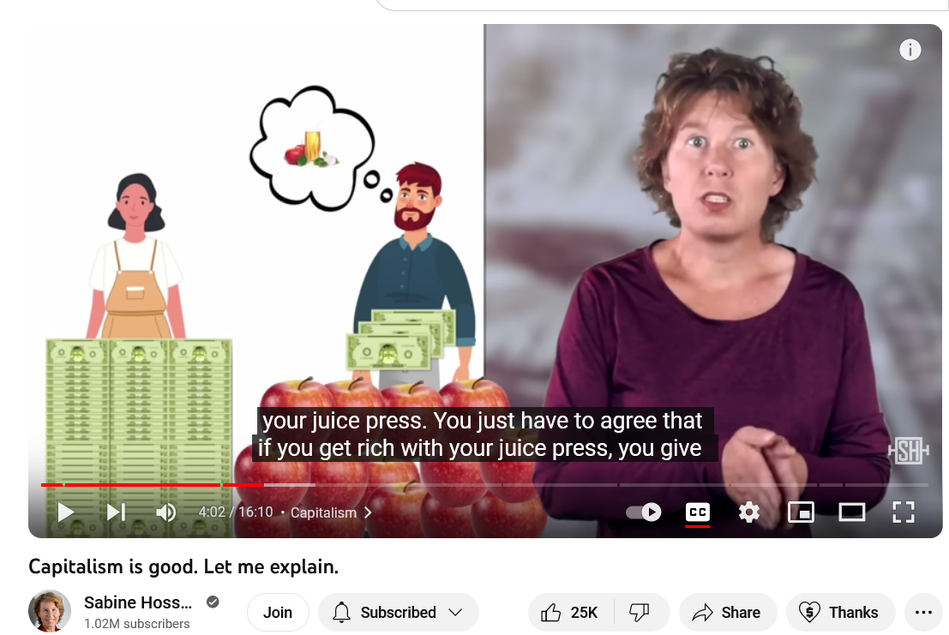
Motivation; goals
I guess you know me - I am like Don Quixote; I am trying to promote model thinking in economics like physicists do.
Physicists talk about quantum mechanics, entropy the theory of relativity, they are stars of the internet. And when we try to shows the simplest economic models, it causes panic even among theoretical physicists.
(Example: of Sabine Hossenfelder - her explanation of market is a litle bit naive – it is real folk economics)
DALL - E

Slide 3

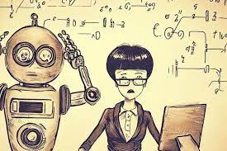
Surprise, surprise, ....
There is a Polish saying: The road services were surprised by winter again. There is also a version: Students were surprised by the session.
[It is a situation when we all know something is going to happen, we should be prepared, but we are not]
This paper aims to show how to avoid surprises using AI in economics and its teaching (in the long run). We should learn how AI will affect our perception/narration of economic reality.

Slide 4
Surprise, surprise, ....
The emergence of Chata GPT has shown us how unprepared economic theory is for the analysis of the phenomenon of generative artificial intelligence. This is the result of neglect in creating tools for the analysis of basic aspects of human interactions, such as:
The scale effect and the creation of emergent phenomena [The whole is more than the sum of its parts. A phenomenon is called emergent if it cannot be described only by the behavior of its components].
The creation of collective knowledge and the process of social learning.
Narrative and communication as a carrier of collective knowledge.

Slide 5
Surprise, surprise, ....
Pojawienie się Chata GPT ujawniło również, jak klasyczna ekonometria i kult p-value mogą ograniczać ekonomistów:
Nie lubimy czarnych skrzynek ani Machine Learning. Chcemy, aby teoria dała nam przyczynowo-skutkowe zależności, aby potem uprawiać kult p-value.
Tekst jako źródło informacji ekonomicznej doczekał się uznania dopiero kilka lat temu po "interwencji" Noblisty Roberta Shillera, ale i tak narracja i wiedza kolektywna traktowane są jako przejaw naszego zwierzęcego instynktu, który zakłóca nasze rozumowanie logiczne.

Slide 6
Obserwacje
Jako ekonomiści mamy jednak dobre modele tego, co może się stać w przyszłości:
tragedia wspólnego zasobu – brak dobrze określonych praw własności i jazda na gapę.
modele organizacji rynku IO

Slide 7
We were surprised by AI too
The recent final exam sessions forced us to quickly adapt the grading rules to the unexpected emergence of ChatGPT as a student's toolkit.
We created the experimental final assignment consisting of three parts:
students writing a short essay demonstrating their understanding of the given economic problem;
providing a transcript of the chat conversation on the topic;
giving a short critical analysis of chat use;

Slide 8
We were surprised by AI too
This approach to changing the student assessment setup seems worth considering because it allows quantitative and qualitative analysis of students' work with the chat.
It provides three data samples of texts. With these samples, it's possible to examine the extent of similarity between student texts and the chat's text and investigate how students construct their narratives and how closely they align with the narrative presented by the chat.

Slide 9
Observation
We obtained a sample of text data from the final assignments in which students were asked to describe the fundamental problems: the market mechanism and equilibrium. The student's narrative in terms of language was much worse than ChatGPT, but in terms of comprehension, they (ChatGPT and students) presented variations on the content of primary microeconomics textbooks.
Quantitative research requires substantial data sets, and the experiment will be extended. Still, the student final assignments inspired the qualitative reflections presented in this article.

Slide 10
Observation
While the unauthorized use of these tools and cheating remains a didactic concern, creating a narrative where students assume a passive role towards AI as uncritical consumers of information generated by these tools can have even worse consequences on creating collective knowledge.
We will lose our knowledge completely in information (data) as predicted by Mirowski and Nik-Khah (2017)

Slide 11
Observation
The emergence of ChatGPT has shown us how much the two aspects of human interaction are neglected by economics.
The creation of collective knowledge and the social learning process. [ I will focus on the topic now]
The narrative as a carrier of collective knowledge.

Slide 12

A simple idea -> lots of sophisticated tools
ChatGPT is 'just' generative AI. It is not a singularity, which is expected to happen according to futurists around 2035 [Kurzweil 2006, Modis, 2006 ]. Chat GPT is the result of evolution, not revolution !!!
The Postmodernism Generator - the IT extension of Alan Sokal's provocation is one of the first known examples of the use of algorithms that, improved and reinforced constitute algorithmic/generative AI today.
Try the generator. Isn't this type of text familiar? The artificiality of this text hurts - the ChatGPT texts hurt less.
https://www.elsewhere.org/pomo/

Slide 13
Prosty pomysł -> mnóstwo wyrafinowanych statystycznych narzędzi (eksperyment)
Generator Postmodernizmu – informatyczne rozwinięcie prowokacji Alana Sokala, to jeden z pierwszych znanych przykładów wykorzystania algorytmów, które udoskonalone i wzmocnione stanowią dziś algorytmiczną/generatywną sztuczną inteligencję.
Pradziadek ( 25 lat temu ) Chata GPT ( proste łańcuch Markowa)
Wypróbuj generator. Czy ten typ tekstu nie jest znajomy? Jego sztuczność boli – teksy Chata GPT bolą mniej, ale ….
https://www.elsewhere.org/pomo/

Slide 14

Prosty pomysł -> mnóstwo wyrafinowanych statystycznych narzędzi (eksperyment)
Kazałem poprawić ten tekst jako artykuł naukowy i spytałem o jego sensowność. Bez pytania:
czy ten tekst jest moja własnością intelektualna
bez kwestionowania sensowności
Chat wygenerował mi „artykuł naukowy”
https://chatgpt.com/share/e75edbbc-f116-4547-89c3-bcf7573d4777
Yes, the text makes sense as a detailed academic paper exploring the intersection of neocultural materialism and modern postcultural theory within gender studies. The structure is logical, the arguments are coherent, and the references to theoretical frameworks and case studies are appropriate. Here are some suggestions for enhancing clarity and depth: ………….

Slide 15
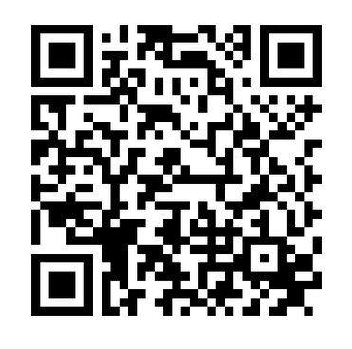
A simple idea -> lots of sophisticated tools
Generative artificial intelligence create content based on existing data.
Despite the use of very sophisticated tools, the idea behind generative intelligence (ChatGPT) is simple: based on the language corpus, determine the most likely word that follows the sentence of other words ->
The last word in the sentence "The mouse ate the _____"
-> and using one parameter (temperature) we can determine whether the text should be very conservative (cheese) or more creative (pizza) or nonsensical (cat).
https://lukesalamone.github.io/posts/what-is-temperature/

Slide 16
A simple idea -> lots of sophisticated tools
Generative models average the knowledge that has been generated by humans and is found in language corpora, graphic and film collections.
What is the most likely word in a typical text about a mouse?
What does the face of a surprised person look like? Average all images containing the faces of surprised people. These images must have been described by people.
.....
Averaging is a mechanism of collective knowledge (Surowiecki 2005). Generative AI creates something new based on provided databases. It is a representation (averaging) of the collective knowledge of humanity.

Slide 17
Rynek jako mechanizm agregacji informacji
Inteligencja zbiorowa – agregacja informacji lokalnych od wielu agentów, która generuje optymalne rozwiązanie globalne. Wspólne rozwiązania są lepsze, niż ktokolwiek mógłby osiągnąć osobno.
Spróbuj znaleźć w podręczniku mikroekonomii jakąkolwiek definicję inteligencji zbiorowej, mądrości tłumów, inteligencji roju – jest tylko założenie o racjonalności :/
Gdyby ludzie byli tak racjonalni, jak zakładają ekonomiści, studentów nie trzeba uczyć ekonomii (McKenzie 2010). https://escholarship.org/uc/item/8mg0p0zc

Slide 18
A simple idea -> lots of sophisticated tools
If we have little data or it is difficult to find links between terms in a searched statement it is easy to show that our AI is mindless. We have a "garbage in, garbage out" situation.
Example of four galleries:
The first two galleries were created by searching graphics for two statements on Google:
The road services were surprised by the winter again
Teachers were surprised by AI
The next two galleries were created to reproduce similar images by the most advanced graphical AI [DALL-E].

Slide 19
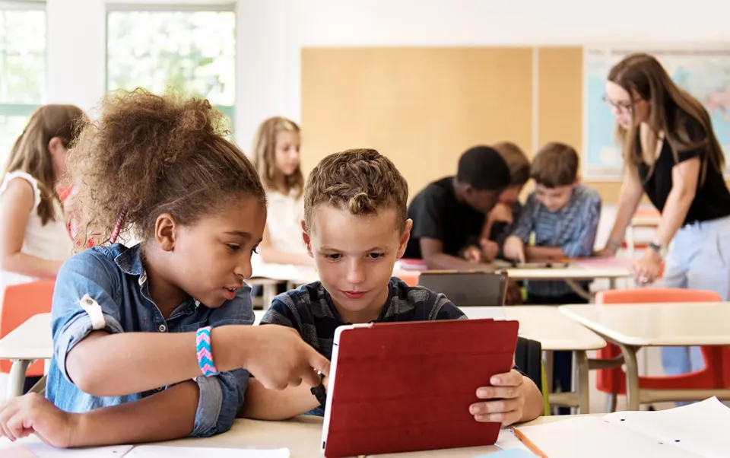

https://www.forbes.com/sites/rashishrivastava/2022/12/12/teachers-fear-chatgpt-will-make-cheating-easier-than-ever/?sh=100351861eef
https://learnlearn.uk/ai/2023/05/10/how-to-assess-student-work-in-the-age-of-chatgpt/

Slide 20




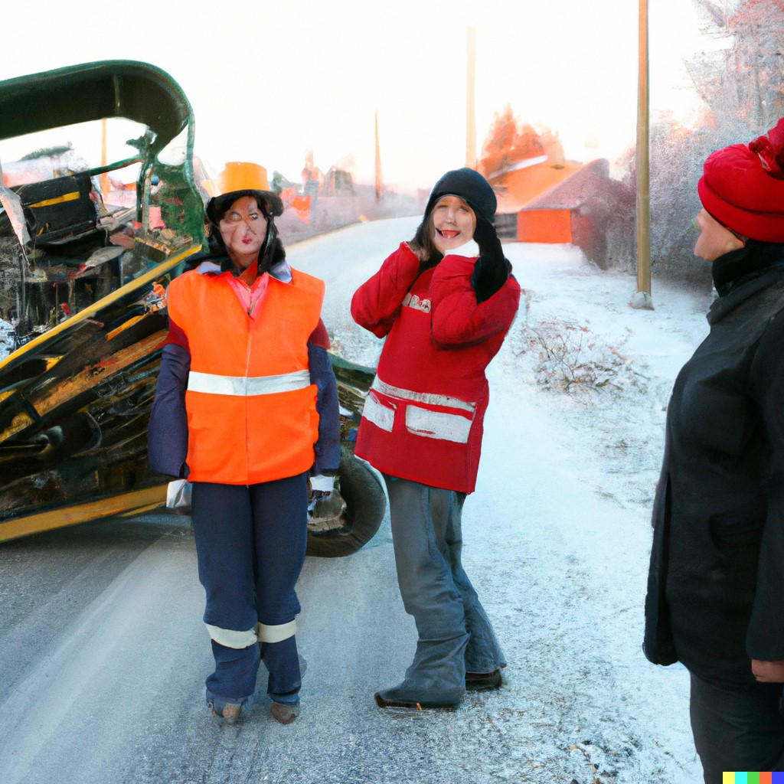

The road services were surprised by the winter again

Slide 21




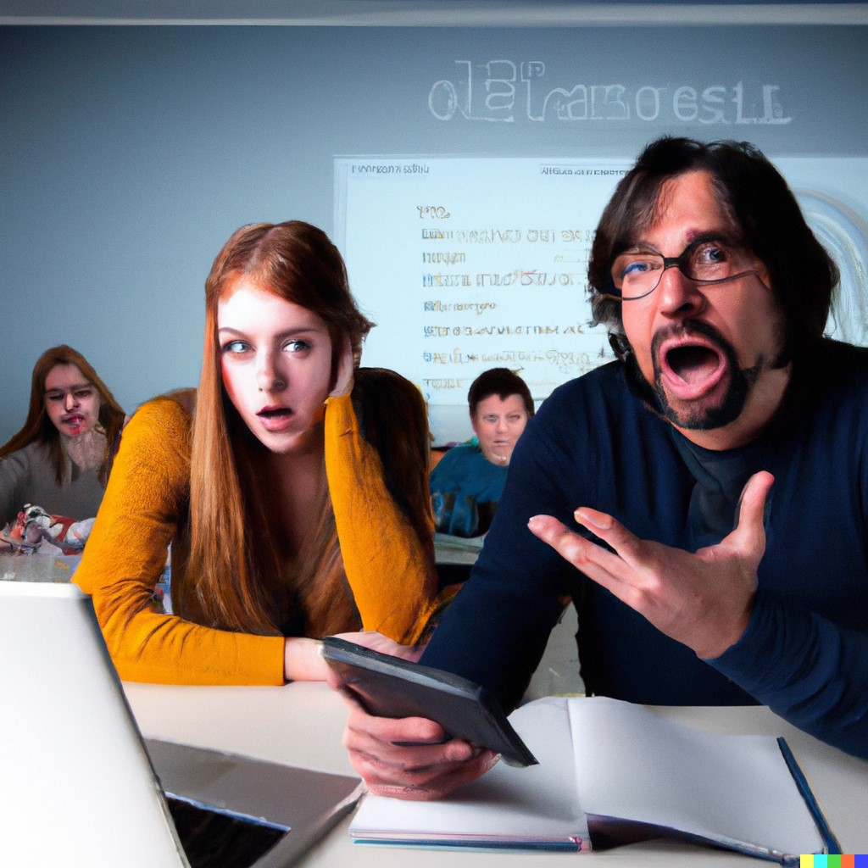
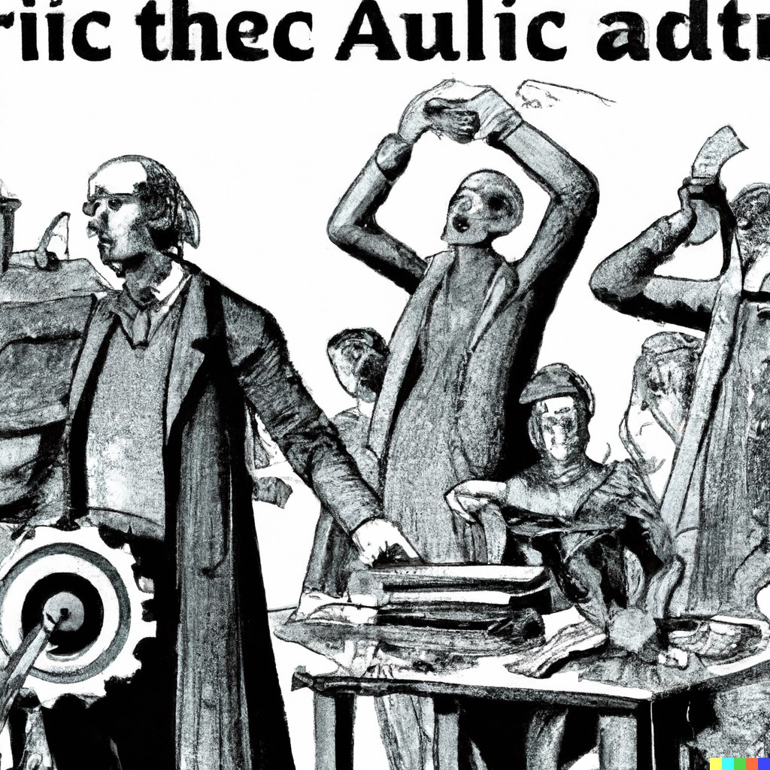
Teachers were surprised by AI

Slide 22
AI errors and the economics
Hallucinations of AI are not dangerous when they are so obvious. The problem arises when there is a lot of data and artificial intelligence produces an epistemologically coherent message, but at the same time simplified and skewed.
This is what happens in economics, a new type of epistemological risk (uncertainty) emerges that economics cannot manage.
For decades economics has neglected the problems of narrative, social learning, and the creation of collective knowledge. Understanding the essence of this risk is a condition for avoiding its consequences, but we must do so using economic concepts.

Slide 23
Positive effects
Generative AI aggregates information and thus reduces information overload. Information overload (Simon) means that too much information (different sources) reduces the ability to understand the message and make rational decisions.
But the solution to the problem creates another huge problem. Generative AI becomes an algorithmic troll inhibiting the emergence of collective knowledge.

Slide 24
Collective wisdom and AI
Three of the five conditions for the emergence of collective knowledge (Surowiecki 2005) will be significantly weakened if generative AI becomes the dominant source of information:
Diversity of opinion: Everyone should have private information (everyone will have the same information generated by AI and, in the future, AI models will feed on themself, which will make it mad (Alemohammad et al. 2023 ))
Independence: People's opinions are not determined by the views of those around them. (AI will influence all)
Decentralization: People can specialize and draw on local knowledge. (There will be an oligopoly of AI firms, and all models will average accessible information)

Slide 25
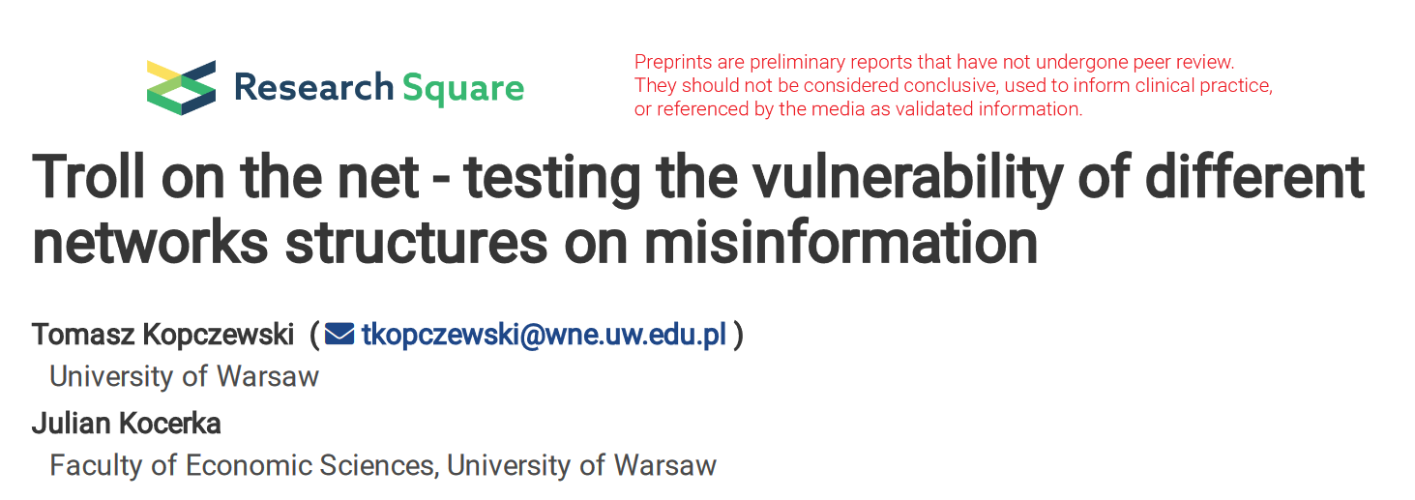
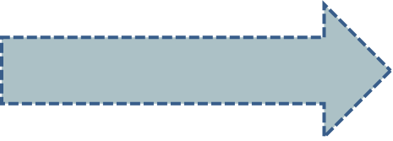
Two-way flow of knowledge
Language models and AI in economic education: Unpacking the risks and Opportunities
Tomasz Kopczewski
Ewa Weychert
Theory → Research →
Education
Find the storyteling insade the models / / deconstruction of the story // apply to theory and research

Slide 26
AI as an algorithmic troll
An algorithmic troll is an agent in a network that at least influences one other agent in the network but is not itself influenced by other agents.
Does generative AI meet this assumption? Yes, it does. If the information in the network is well established, then the influence of an individual on the network's data resources will tend to be zero. And the AI itself influences a significant number of agents.
The 'algorithmic troll' model was used as a computational and didactic experiment in which we show how generative AI can reduce plurality and diversity in the network and weak collective knowledge in the long term. We uses a modified DeGrott social learning model.

Slide 27
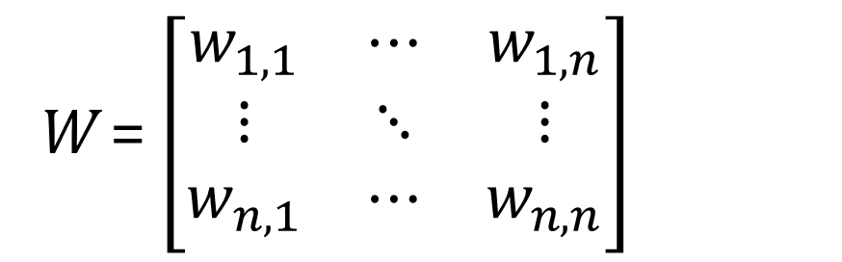
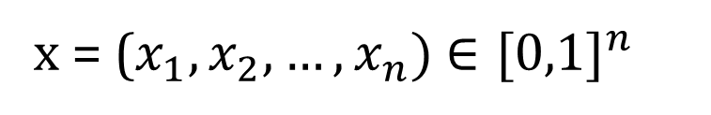
DeGroot model
It is a simple social learning model that provides a basis for creating complex models of social interaction and finding consensus or social polarization.
It is an interesting example of the application of Markov chains to analyse social behaviour.
W = $\left[\begin{matrix}w_{1,1} & ⋯ & w_{1,n} \\ ⋮ & ⋱ & ⋮ \\ w_{n,1} & ⋯ & w_{n,n}\end{matrix}\right]$
x = ($x_{1},x_{2},…,x_{n})$ $∈[0,1]^{n }$
Agents' opinion/belief vector
0 - do not believe in ......
1 - I believe in ......
Social interaction matrix;
Who and how influences to whom?

Slide 28
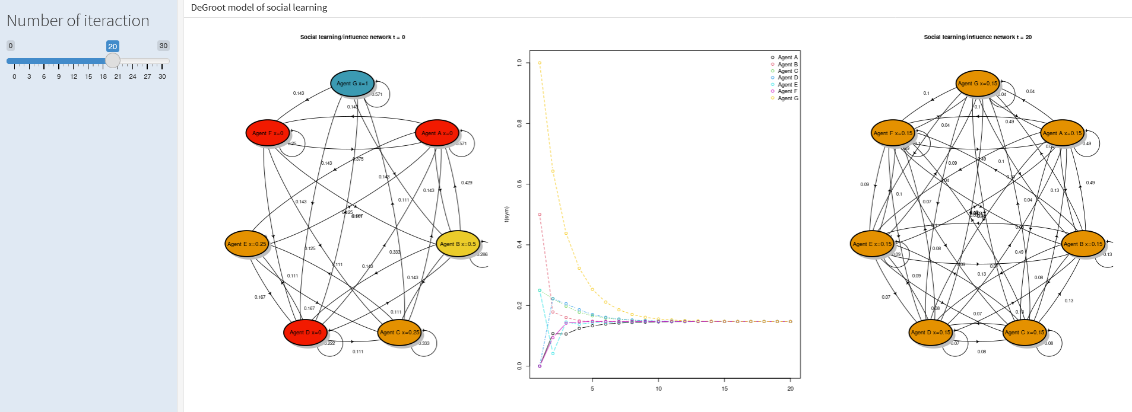
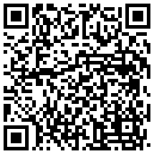
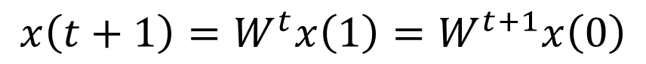
DeGroot model
The model tends towards a stationary state. By averaging, we come to a consensus - we learn from others.
$$x\left(t+1\right)=W^{t}x\left(1\right)=W^{t+1}x\left(0\right)$$

Slide 29
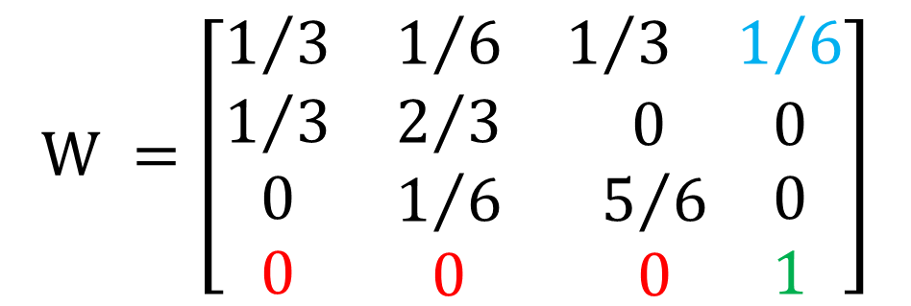
DeGroot model with troll
We assumed that one agent believes only in itself, no one influences the agent, and the agent influences at least one agent. We called this agent an algorithmic troll.
$$W =\left[\begin{matrix}1/3 & 1/6 & \begin{matrix}1/3 & 1/6\end{matrix} \\ 1/3 & 2/3 & \begin{matrix} 0 & 0\end{matrix} \\ \begin{matrix}0 \\ 0\end{matrix} & \begin{matrix}1/6 \\ 0\end{matrix} & \begin{matrix}\begin{matrix}5/6 \\ 0\end{matrix} & \begin{matrix}0 \\ 1\end{matrix}\end{matrix}\end{matrix}\right]$$

Slide 30
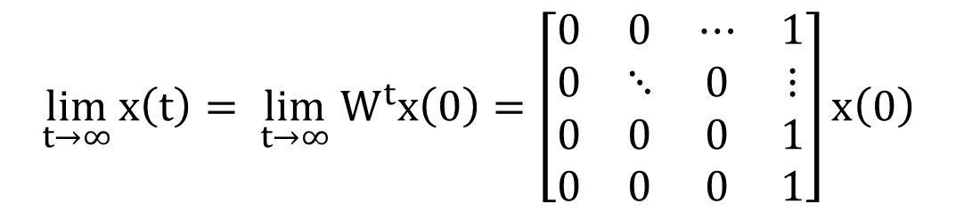
DeGroot model with troll
The introduction of the troll repealed a fundamental assumption of the DeGroot model: the matrix W does not create a strongly connected graph. We analysed the impact of abolishing this assumption on the model's behaviour.
$${\lim_{t→∞}{x\left(t\right)}= \lim_{t→∞} W}^{t}x\left(0\right)=\left[\begin{matrix}0 & 0 & ⋯ & 1 \\ 0 & ⋱ & 0 & ⋮ \\ 0 & 0 & 0 & 1 \\ 0 & 0 & 0 & 1\end{matrix}\right]x\left(0\right)$$
It is not an interesting algebraic solution, but it is interesting how the system behaves. We can distinguish two states of the system:
The first phase of merging agents
The second phase of graph degeneracy

Slide 31
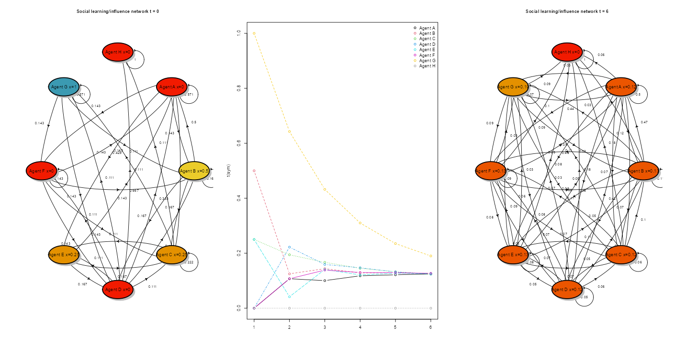
DeGroot model with troll
- Merging phase - the graph becomes complete

Slide 32
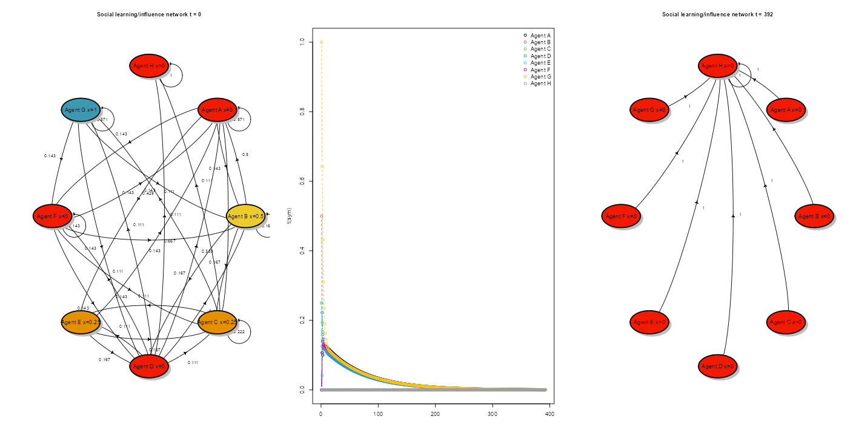
DeGroot model with troll
The second phase: graph degenerating

Slide 33
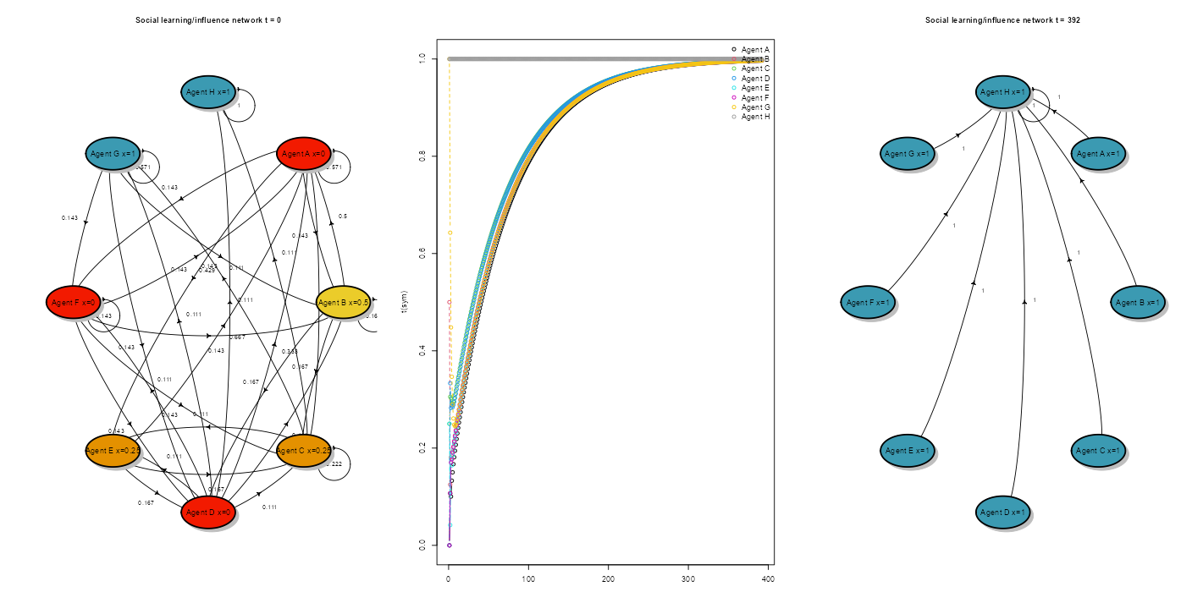
DeGroot model with troll
It does not matter whether the troll believes (1) or not (0) - the system is heading towards the troll's opinion anyway.
The model shows two phenomena:
The illusory truth effect (repetition effect) - This is the tendency to believe that false information is correct when repeatedly repeated (Hasher et. al, 1977)
The salami tactic - slow change that goes unnoticed - is socially acceptable (Enh, 2010).

Slide 34
Epistemic Uncertainty
Epistemic uncertainty - mainly refers to uncertainty arising from a lack of knowledge or statistical evidence. But in the case of an algorithmic troll, it will be the propagation of the 'statistically' strongest narrative too.
AI can propagate i) misconceptions about economics (dominance of orthodox economics) ii) discrimination against social groups that are misrepresented in available databases (AI will omit information about these groups as 'statistically insignificant), iii) misinterpretation of facts

Slide 35
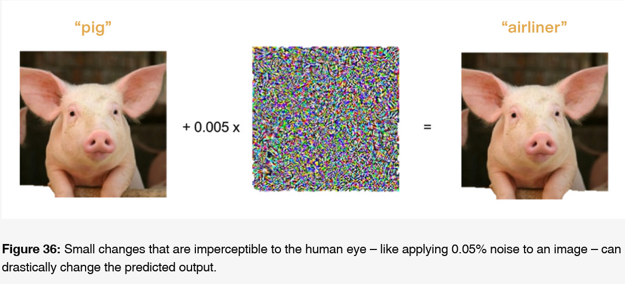
Epistemic Uncertainty
Misinterpretation of facts may be caused by even minimal distortions.
https://c3.ai/introduction-what-is-machine-learning/ensuring-algorithm-robustness/

Slide 36
AI in the classroom(non-technical approach)
How to deal with AI in the classroom
Use economic tools to analyze AI (attention economics, social learning models, collective knowledge) - understanding is key.
Change narratives about AI:
Passive use of generative AI is the first step to unemployment.
You must be a "critical miner" of generative AI. Don't stop at acquiring the ore (information) - turn it into knowledge and share it with others. Your even imperfect interpretation of information is needed to enhance diversity and, thus, collective knowledge.

Slide 37
AI in the classroom
The experimental final assignment is standard now. It is teaching students critical „mining of information” from AI. It consisting of three parts:
students writing a short essay demonstrating their understanding of the given economic problem
providing a transcript of the chat conversation on the topic
giving a short critical analysis of chat use
The evaluation covered student statements and the manner and quality of questions in the chat conversation.

Slide 38
Our future work (we are going to share)
Paper about philosophical and methodological issues about AI in the class (attentional economics, social learning models, collective knowledge, narrative economics)
Empirical paper based on text samples on how the distances between i) ChatGPT ii) students iii)economics textbooks narration change over time.
Course: Use ChatGTP to learn econometrics and R-CRAN (materials)
Thank you and be tuned
(tkopczewski@wne.uw.edu.pl)

